Slide 1
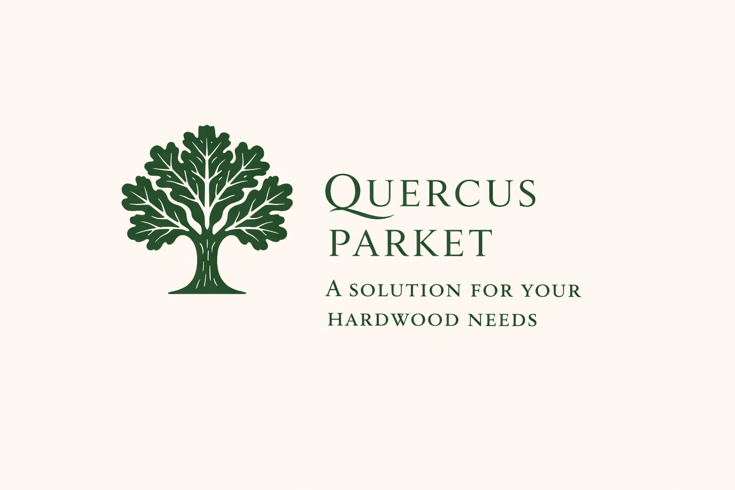

Slide 2
Introduction
A second-generation, family-owned sawmill (est. 1997), dedicated to precision, consistency, and exceptional quality. Specialising in the production of premium-grade ash and oak timber, alongside classic solid and engineered parquet flooring.
Core expertise lies in Quercus robur (common oak), widely recognised as Slavonian oak, esteemed for its strength, structural integrity, and enduring aesthetic appeal.
All sourcing is fully traceable and compliant with international regulations (EUDR, EUTR, UKTR, Lacey Act) across Southeast Europe.
Primary origin: the Morović forest (Serbia) — a source of superior, sustainably managed oak with a distinguished forestry heritage.
The company seamlessly combines traditional craftsmanship with advanced production methods, further strengthened by an international manufacturing partnership in Cambodia.

Slide 3
History
1997–2009 | STRELA Era Foundation phase — established as Serbia’s largest oak and ash sawmill, focused on precision and high-volume export. A long-term agreement with Vojvodinašume ensured a consistent supply of premium Slavonian oak (Quercus robur). Developed a strong international presence (EU, Middle East), including prestigious projects such as the Azerbaijani Royal Palace.
2009–2020 | QUERCUS PARKET Era Strategic transition from volume-driven production to specialisation and long-term partnerships. Became a trusted supplier of semi-finished oak components to leading flooring manufacturers (e.g. Tarkett, Bauwerk, Weitzer).
2020–Present | CAMPICO Era Global expansion through a joint venture in Cambodia, focusing on advanced three-layer oak flooring for the US market. Integration of European raw material expertise with international manufacturing and distribution networks.
Continuous evolution from a large-scale sawmill into a specialised, globally connected oak producer — remaining family-owned and now led by the second generation.

Slide 4
Turnkey Hardwood Processing Facility
A fully operational industrial hardwood platform in Serbia (est. 1997), offering immediate revenue generation.
Location Advantage Direct access to Slavonian oak (Quercus robur) from Morović and the Spačva Basin, with efficient connectivity to EU and global markets.
Financial Performance Approximately €16.5M revenue, €2M profit, ~100 employees, with scalable industrial capacity.
Infrastructure Well-established production facilities (8,000 m² built area on a 36,000 m² site), equipped with high-capacity European machinery.
Supply Security Long-term agreement with Vojvodinašume and FSC-certified sourcing, fully compliant with EUDR, EUTR, and the Lacey Act.
Growth Potential Ready for expansion into veneer, wear layers, and engineered wood — no greenfield investment required.
Strategic Positioning A vertically integrated platform combining sourcing, processing, and export, backed by nearly three decades of operational expertise.

Slide 5
Sourcing, Compliance & Traceability
All timber (oak Quercus robur and ash Fraxinus excelsior) is sourced exclusively from legally harvested forests.
Regional sourcing spans Serbia, Croatia, Bosnia & Herzegovina, and Romania, with a core focus on Morović forest (Serbia).
Long-term partnerships with state forestry enterprises (Vojvodinašume) ensure supply continuity.
Strict supplier verification includes legal documentation, harvesting rights, and ongoing compliance monitoring, with FSC or equivalent standards applied where relevant.
A comprehensive traceability system enables full tracking from forest origin to finished product.
Fully aligned with EUTR, EUDR, UKTR, and the US Lacey Act, ensuring minimal risk of non-compliant timber.
Risk mitigation includes a diversified supplier base, preference for state-managed forests, physical verification, and regular audits.
Strong commitment to sustainability through responsible sourcing, support for forest regeneration, and efficient material utilisation.

Slide 6
Market Opportunity – European Oak & Hardwood
Robust global demand for high-quality oak and ash across furniture, interior design, and industrial sectors.
Limited supply of Slavonian oak (Quercus robur), making it a premium and highly sought-after resource.
Southeast Europe remains a strategically vital sourcing region, renowned for top-grade hardwood and established forestry systems.
Increasing regulatory and ESG pressures favour fully compliant and traceable suppliers.
Stable long-term demand across multiple industries ensures resilient market fundamentals.
A fragmented supply landscape creates significant opportunities for reliable, scalable, and compliant producers.

Slide 7
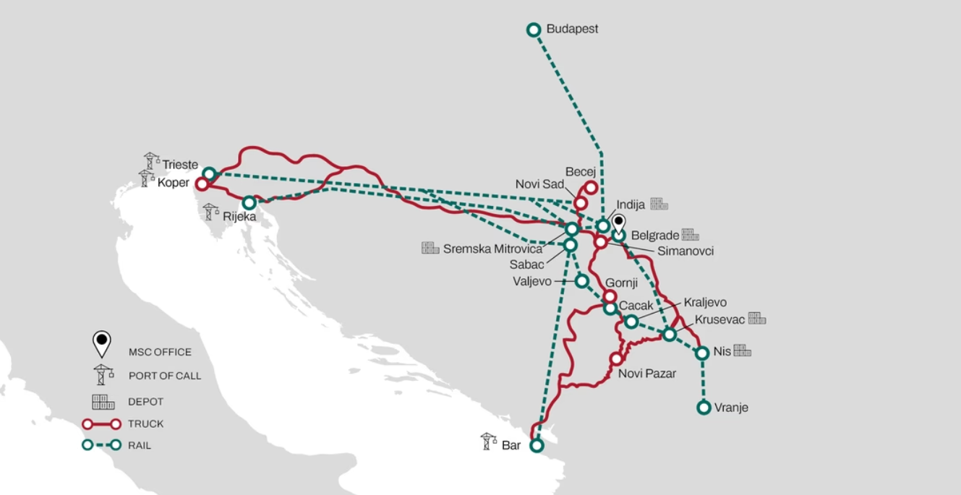
Strategic Hub – Raw Material & Export Access
Located in the Srem region (Serbia), near Belgrade — a key logistics hub.
35 minutes from Belgrade International Airport
10 minutes from major European motorways (E-70, E-75)
Close proximity to rail and customs terminal in Inđija
Immediate access to prime sourcing regions: Morović forest (Serbia) and Spačva Basin (Croatia)

Slide 8


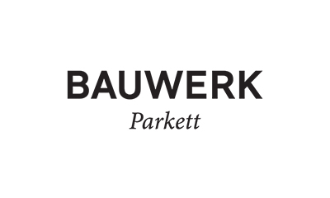
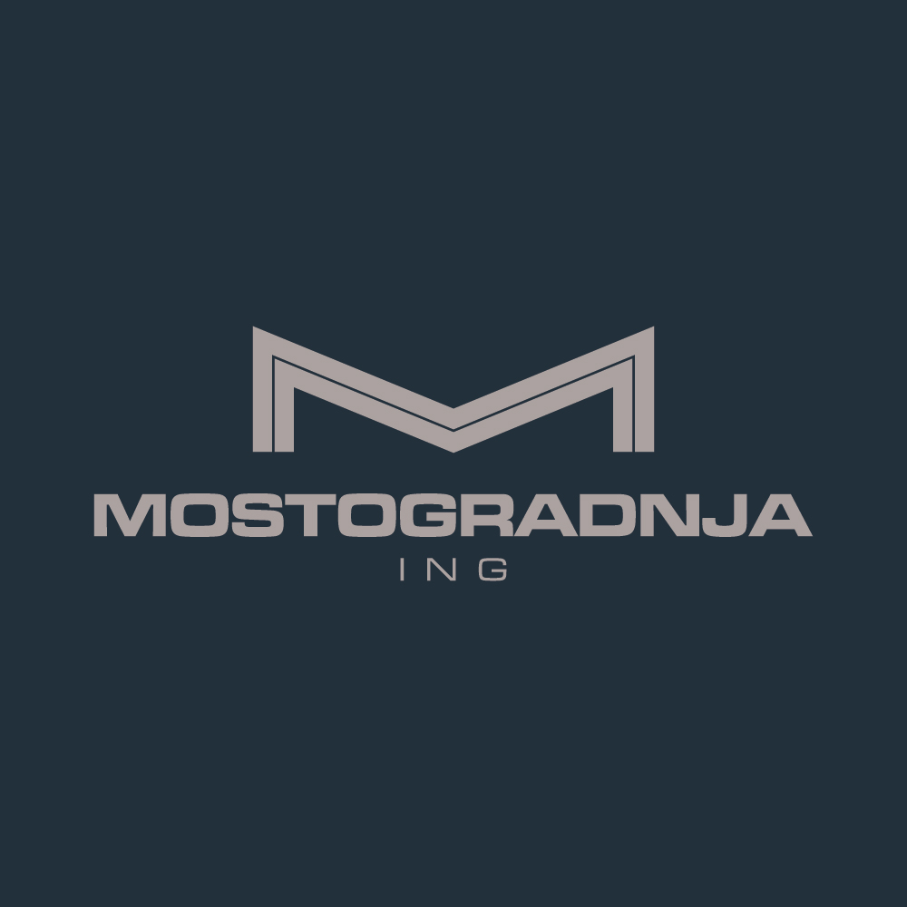


Client Portfolio & References
Member of FORDAQ (Bronze Level)

Slide 9
Contact & Company Details
QUERCUS PARKET – Sole Proprietorship
Address: Nikole Tesle 137, 22321 Ljukovo, Serbia
Contact: Email: quercus.parket@gmail.com Phone: +381 22 58 77 50
Working Hours: Monday – Friday | 07:00 – 15:00
Company Information: TIN (PIB): 106197782 Registration No. (MB): 61620117
Banking Details: OTP Bank Serbia (Novi Sad) IBAN (EUR): RS35 3259 6015 0046 8686 36 SWIFT: OTPVRS22
Location Reference: Pilana “Strela” – Quercus Parket (Google Maps)
FSC Licence Holder: C214521

Slide 10
THE END. THANK YOU!
Legal Notice:© QUERCUS PARKET. All rights reserved.All information contained in this presentation is confidential and intended solely for the recipient.No part of this presentation may be reproduced, distributed, or disclosed without prior written consent of QUERCUS PARKET.

Slide 11
